Slide 1
Home Automation using Bluetooth
Made by PC35 Prakhar Singh Rajput PC33 Mayannk Kumar Singh PC41 Abhijeet Takle

Slide 2
Aim and objective
AIM:
To create a device to control the activity of the household devices via Bluetooth.
OBJECTIVE:
To create circuit for device and connecting devices.
To design the software.

Slide 3
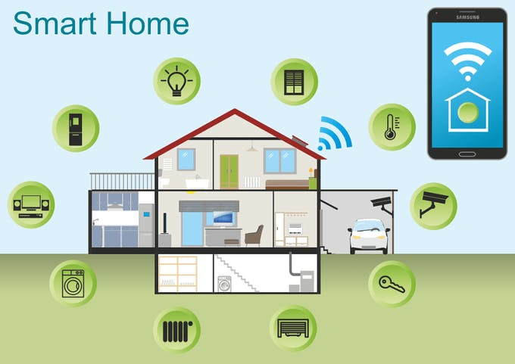
Introduction
Electronic devices and appliances have become very common in this recent year of technology especially with fast development in smartphones. In this case study, the design of Home Automation System compatibly with Local housing and good features for home automation via remote access are presented. Bluetooth Based Home Automation System Using Silicon labs C8051F340 and HC-05 Bluetooth modulus is design and implemented.

Slide 4
Serial Communication
Serial communication is the process of sending data one bit at a time, sequentially, over a communication channel or computer bus.
SCON register is used to setup serial communication.

Slide 5
System Block Diagram
C8051F340
Relay
Light
TV
Bluetooth Modulus HC05
AC
Fan
Lamp
Fig. 1:System Block Diagram

Slide 6
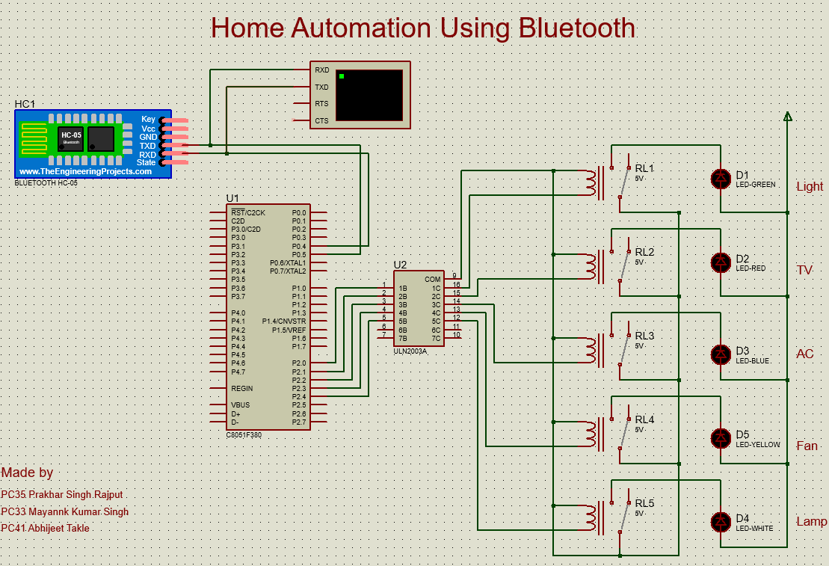
Interfacing Diagram
Fig. 2 :System interfacing diagram

Slide 7
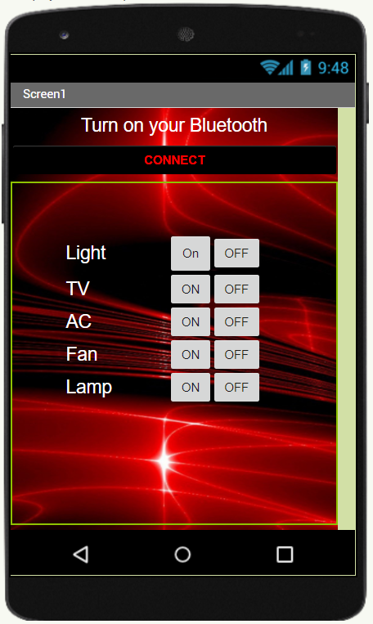
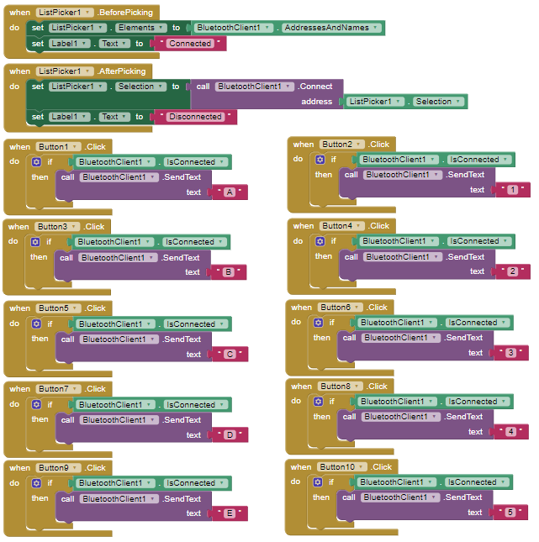
MIT App Inventor

Slide 8
Advantages
Inefficiency of Operation
Loss of Power
Application Devices
Safety
Security
Flexibility

Slide 9
Application
Rebuilding consumer expectations, home automation has been projected to target wide array applications for the new digital consumer. Some of the areas where consumers can expect to see home automation led IoT-enabled connectivity are:
Lighting control HVACLawn/Gardening management Smart
Home Appliances
Improved Home safety and security Home air quality and water quality monitoring
Natural Language-based voice assistants
Delivery AI-driven
Smart Switches
Smart Energy Meters

Slide 10
Thank you

